Slide 1
PRESENTATION
On
“SECURE DATA HIDING AND EXTRACTION USING LSB TECHNIQUE”
Presented by
      SUDHA. MANE

Slide 2
CONTENTS
Abstract
Introduction
Objective
Methodology
Steganography System
Algorithm Description
Applications
Future Scope
Conclusion
References

Slide 3
ABSTRACT
Secure data hiding uses Steganography. It is the science of hiding information.
The goal of Steganography is to hide the data from a third party.
Also it lets you embed or hide important or private messages or files into any digital files like audio, pictures and videos. It achieves this by using the Least Significant Bits (LSB) of these files.
It allows embedding messages and files in compressed form using ZIP Compression format .
SECURE DATA HIDING AND EXTRACTION USING LSB TECHNIQUE
1

Slide 4
INTRODUCTION
Providing Security to data during communication has became a difficult task these days. Here we propose a technique called Steganography to settle this problem.
To secure data transmission by Multi layer encryption. One is Cryptography and the second is Steganography. As to make the task of Cryptanalyst difficult by introducing two layers.
  Cryptography disguises the content of a message.
  Steganography disguises the existence of the message.
SECURE DATA HIDING AND EXTRACTION USING LSB TECHNIQUE
2

Slide 5
OBJECTIVE
The main Objective of Steganography is to provide security to Secrete communications.
    An example of this is Digital photo album, where information related to a photo such as date and time taken, exposure parameters and scene can be embedded in the photo.
SECURE DATA HIDING AND EXTRACTION USING LSB TECHNIQUE
3

Slide 6
METHODOLOGY
Firstly, we are encrypting the data to be transmitted using the DES Algorithm.
Then the encrypted data is embedded (Steganographed) behind the digital files like audio, video and pictures, using LSB Technique.
And now the data is ready for Secure transmission and the vice versa is done at the receiver’s side.
Also, Compression Technology has been used to compress the size of the message in order to save memory.
SECURE DATA HIDING AND EXTRACTION USING LSB TECHNIQUE
4

Slide 7
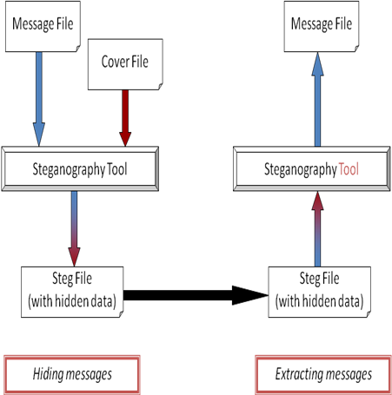
STEGANOGRAPHY SYSTEM
SECURE DATA HIDING AND EXTRACTION USING LSB TECHNIQUE
5

Slide 8
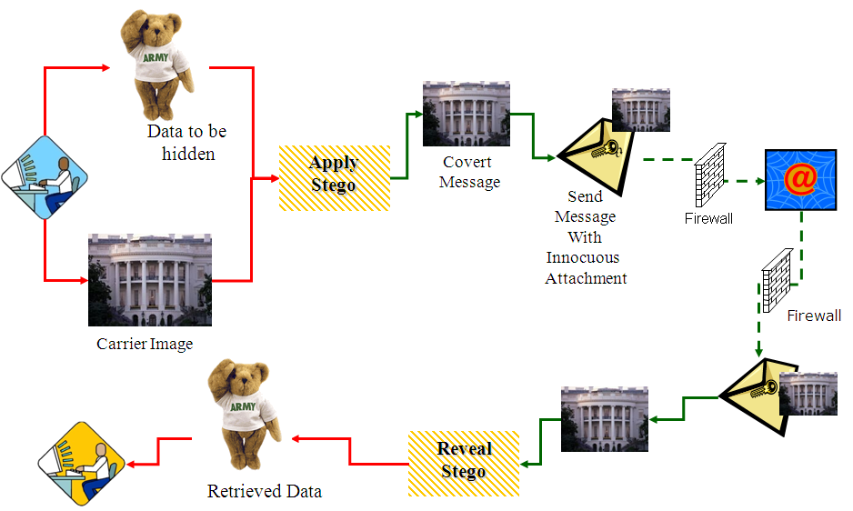
EXAMPLE
SECURE DATA HIDING AND EXTRACTION USING LSB TECHNIQUE
6

Slide 9
ALGORITHM DESCRIPTION
we are going to embed the encrypted data into a digital files using LSB Technique.
The encryption is done by using DES Algorithm with the help of key that will be used as Password.
LEAST SIGNIFICANT BIT (LSB) TECHNIQUE :
  The Least Significant Bit (in other words, the 8th bit) of some or all of the bytes inside an image is changed to a bit of the Secret message.
  For example a grid for 3 pixels of a 24-bit image can be as follows:
        (00101101 00011100 11011100)
        (10100110 11000100 00001100)
        (11010010 10101101 01100011)
SECURE DATA HIDING AND EXTRACTION USING LSB TECHNIQUE
7

Slide 10
  When the number 200, whose binary representation is 11001000, is embedded into the Least Significant Bits of this part of the image, the resulting grid is as follows:
        (00101101 00011101 11011100)
        (10100110 11000101 00001100)
        (11010010 10101100 01100011)
DATA ENCRYPTION STANDARD (DES) :
  DES encrypts a 64-bit block of Plaintext as input and decrypts a 64-bit block of Cipher text as output.
  DES has a key of 56 bits in length and it uses both Permutations and Substitutions in the algorithm.
  DES has 16 rounds, meaning the main algorithm is repeated 16 times to produce the Cipher text.
SECURE DATA HIDING AND EXTRACTION USING LSB TECHNIQUE
8

Slide 11
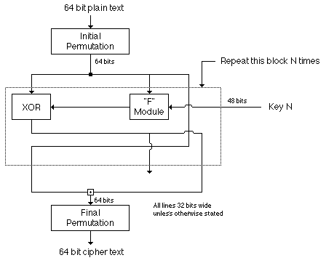
Fundamentally DES performs only two operations on its input :
      Bit Shifting.
      Bit Substitution.
      DES BLOCK DIAGRAM
SECURE DATA HIDING AND EXTRACTION USING LSB TECHNIQUE
9

Slide 12
STEPS TO EMBED MESSAGE IN A
CARRIER FILE
    Load the Carrier File in which you want to hide data.
    Set Slider Compress Value and assign to COMPRESS RATIO.
    Read The Password Value.
    Type Message to be hidden in text box.
    Read Length of message from text box.
    Please enter Message.
    Replace LSB of Carrier File with the Message in the text box.
    Save the Covered File and remember the Password.
    Exit.
SECURE DATA HIDING AND EXTRACTION USING LSB TECHNIQUE
10

Slide 13
APPLICATIONS
Steganography relate to secret communications.
This technique is used for Digital Watermarking purpose.
This technique also prevents unauthorized copying of data by embedding a Copy-right mark behind the digital file which is an acceptable piece of evidence in court.
This technique is useful in the sector of Defense for secure and secret communication.
SECURE DATA HIDING AND EXTRACTION USING LSB TECHNIQUE
11

Slide 14
FUTURE SCOPE
Expand knowledge base by developing profiles for Steganography applications.
Enhancing the tool developed to capture all changes to system when a Steganography application is installed.
Developing “proof-of-concept” experiments to demonstrate.
SECURE DATA HIDING AND EXTRACTION USING LSB TECHNIQUE
12

Slide 15
CONCLUSION
In “Secure Data Hiding and Extraction using LSB Technique” :
We are going to encrypt the text data or data file using DES Algorithm.
Later we will embed the encrypted data to a digital file using LSB Technique.
At the receiver side the receiver has to enter the Password which was used at the time of encryption.
So it helps in providing double Security to the data such as Cryptography and Steganography.
SECURE DATA HIDING AND EXTRACTION USING LSB TECHNIQUE
13

Slide 16
REFERENCES
Johnson, N. F., Duric, Z., Jajodia, S. Information Hiding: Steganography and Watermarking- Attacks and Countermeasure. Kluwer Academic Press. Norwrll, MA, New York, the Huague, London, 2000.
M. D. Swanson, M. Kobayashi and A. H. Tewfik, “Multimedia Data-Embedding and Watermarking Technologies,” Proceedings of the IEEE, Vol. 86, no. 6, pp. 1064-1087, June, 1998.
D. Mukherjee, J. J. Chae and S. K. Mitra, “A Source and Channel Coding Approach to Data Hiding with Application to Hiding Speech in Video,” Proceeding of IEEE ICIP ‘98, Vol. 1, pp. 348-352, Chicago, October, 1998.
J. J. Chae, D. Mukherjee and B. S. Manjunath, "Color Image Embedding using Multidimensional Lattice Structures," Proceedings of IEEE International Conference of Image Processing (ICIP ’98), Vol. 1, pp. 460-464, Chicago, Illinois, October, 1998.
Andersen, R.J., Petitcolas, F.A.P., on the limits of steganography. IEEE Journal of Selected Areas in Communications, Special Issue on Copyright and Johnson, Neil F. and Jajodia, Sushil.
SECURE DATA HIDING AND EXTRACTION USING LSB TECHNIQUE
14

Slide 17


Slide 18


